Slide 1
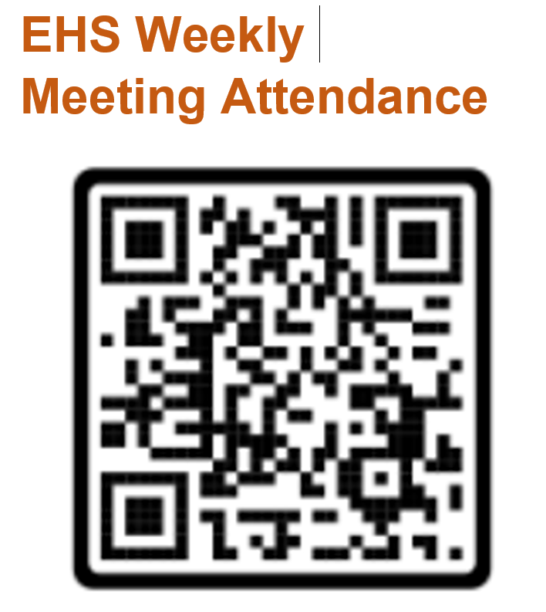
Please scan this QR Code for your attendance

Slide 2
Sparrow EHS Managers’ Meeting
February 23, 2025
WW09

Slide 3
Agenda
General Topics and News- Sam Dixson
AAR- Raz Electra Elevators
Campaign Messages
Area Assessment- Lahav Koralker
Plan your work, Work your plan- Lior Wajcman
Learn From Everything- Sam Dixson

Slide 4
WW09 General Topics and News

Slide 5
WW09
The Sarens crane area close for any human. Please avoid cutting corners and passing the crane's path. A detour should be taken to go around it.
LOTO is required whenever something COULD be turned on and we need to work on or near it. Each person needs their own lock.
Crane dismantle complete, area still closed for damage evaluation and repairs.
The activities of mobile cranes have changed, crane is now operating from 6:00 AM to 4:00 PM.
UFOC and protocol training required to work under the RMF or on top of the ceiling grid in the clean room.

Slide 6
Campaign Messages
Area Assessment
Plan your work, Work your plan- Learn From Everything-

Slide 7
Area Assessment
When arriving at the work area, before starting any work, a scan and inspection of the area must be carried out to ensure it is free of hazards or dangers. If risks cannot be minimized or eliminated, at least be aware of them.
Here is a list of some topics that need to be checked before starting work:
Visual inspection of the work area.
Check for any active or live systems around us.
Check for any openings or holes in the area, including ensuring the proper covering of openings or holes. If a hazard is found, report it and do not begin working near the hazard.
Verify approval for all relevant plans and forms for the task (RAMS, fall arrest plan, confined space, hot work, working at height, HRA, and more).

Slide 8
Plan your work, Work your plan
When you want to do a job, you must first plan how to do it.
The required task planning time must be taken into account, which includes the coverage of all the relevant parameters by all the departments, the work plan department, the safety department and the quality department.
The planning phase is critical and important for the safety of the workers and the success of the work.
Field personnel should always be used when planning the steps of a task, their professional experience in the field can and should be considered, and the guys who going to be do the work should be involved in the planning.
In this way, it is possible to reach high-quality planning, when all factors are considered.
After planning and approving the task, all team members must be shared with all the details, including the details of the task, what the risks are and how to minimize them as much as possible, what the employees should be careful of during the activity, etc., in other words, we expect the team to know and understand the task for which they received approval and the method of execution .

Slide 9
Learn From Everything
In the construction industry, learning from mistakes and accidents is vital for ensuring both safety and efficiency on job sites. Each incident, whether minor or severe, provides a crucial opportunity to analyze what went wrong and make necessary adjustments to prevent future occurrences.
Creating a culture where workers feel safe to report errors without fear of punishment is essential. This openness allows for the collection of valuable insights, which can lead to improved training programs, enhanced safety protocols, and better communication among team members. Such a proactive approach not only safeguards the workforce but also boosts productivity by reducing downtime associated with accidents.
Ultimately, the commitment to learning from every mistake transforms challenges into opportunities for growth, helping both workers and organizations navigate the complexities of the construction environment more effectively.

Slide 10


On-Site Insights
Building a Safer Workplace
December| 2024

Slide 11

On-Site Insights
Building a Safer Workplace
Safety is a shared responsibility, and the best way to reinforce safe practices is through open communication and real-life learning.
The On-site Insights program is designed to create a stronger connection between safety officers and on-site workers by turning real-world incidents into powerful teaching moments.
Via dedicated field tours, safety officers will visit teams directly on-site to:
    Share recent safety events from across the construction site.
    Facilitate interactive discussions, asking workers what they recall about last events, their thoughts on prevention, and lessons learned.
    Provide practical tips to prevent similar incidents in the future.
1
2
3

Slide 12
On-Site Insights
Building a Safer Workplace
This program isn’t just about teaching—it’s about listening.
Workers will have the opportunity to share their own experiences, suggest safer practices, and raise concerns or ideas that supervisors should consider

Slide 13

On-Site Insights
Building a Safer Workplace
On-site Insights field tour questions
1 – “What injury events do you remember from the
last few weeks”?
2 - "How could these injuries be prevented?"
3 – “Can you share similar experiences you’ve
encountered”?
4 – ”What will you do differently and safely
tomorrow”?

Slide 14



On-Site Insights
Building a Safer Workplace
On-site Insights field tour ➔ Measuring & Documenting
Number of workers coached
Knowledge
level
Engagement
level
And…
Teams’ Insights
Smartsheet link: https://app.smartsheet.com/b/form/5ecbd6f1b00341c18d74408559c8a970

Slide 15

On-Site Insights
Building a Safer Workplace
DECEMBER
On-site Insights field tour - Closing
2024
Distribute hard hat stickers to the workers.
Thank everyone for their participation and encourage them to apply the safe practices daily
ON-SITE
INSIGHTS

Slide 16
On-Site Insights
Building a Safer Workplace
The process
Sharing materials
Perform On-site Insights field tour
CEHS send a Kit with:
LLs of safety events
hard hat Stickers
Smartsheet link to upload info
Safety officer ask the 4 questions
Fill out the smartsheet link

Slide 17
Questions?

